Slide 1


UNNATI SAXENA Data Science intern at Oasis Infobyte

Slide 2

TASK 2
ANALYSIS WITH PYTHON

Slide 3

Unemployment is measured by the unemployment rate which is the number of people who are unemployed as a percentage of the total labour force. We have seen a sharp increase in the unemployment rate during COVID-19, so analyzing the unemployment rate can be a good data science project.

Slide 4
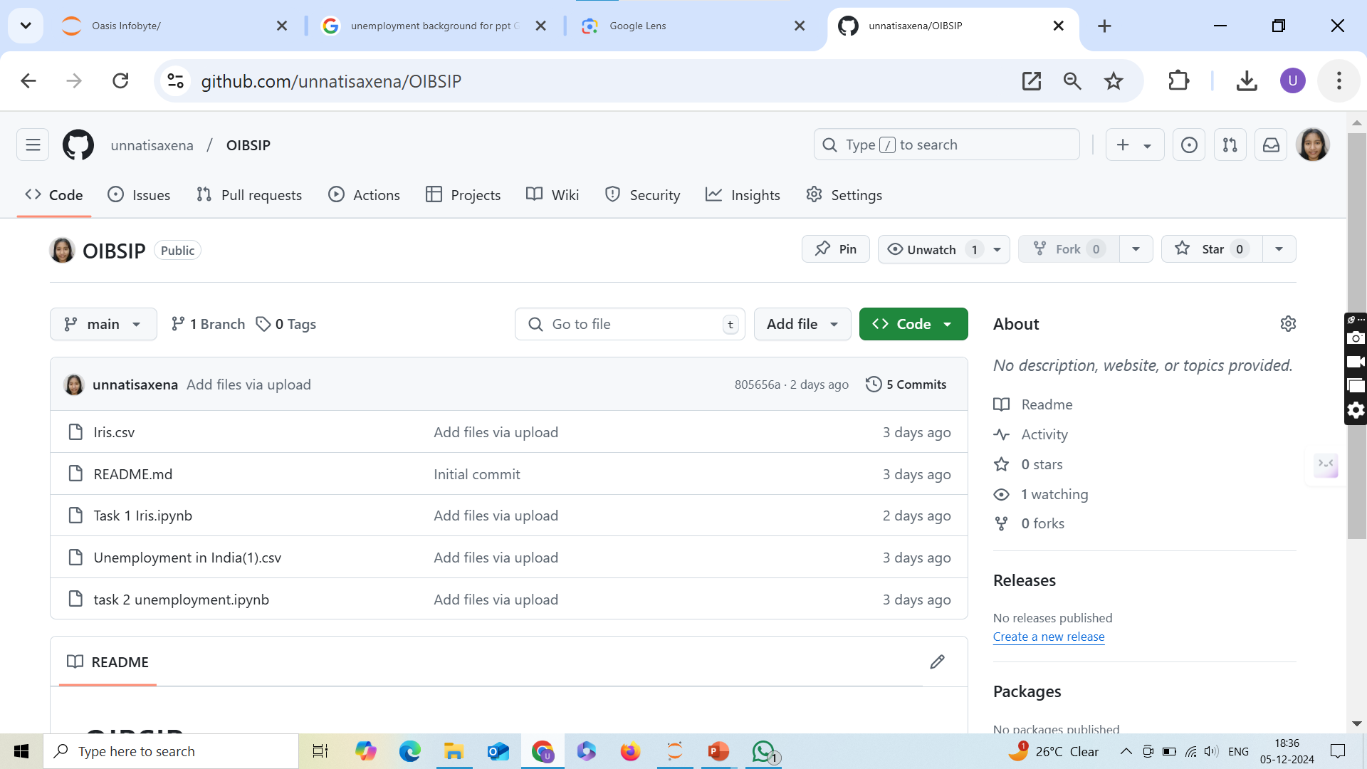
CHECK THE CODE IN THE GITHUB REPOSITORY https://github.com/unnatisaxena/OIBSIP

Slide 5

Questions? Let me Know. LinkedIn: https://www.linkedin.com/in/unnatisaxena/

